Slide 1
Securitized banking and run on repo -Gary Gorton, andrew metrick
Topic in Quantitative Finance
-Jing’ai Chen

Slide 2
The panic of 2007-2008?
Run on sale and the repo market
Mechanism for this new kind of bank run?

Slide 3
CONTENTS
Introduction
Institutional background
State variables
Data
Empirical tests
Conclusion

Slide 4
Introduction
Traditional banking
Securitized banking
Making and holding loans, with insured demand deposits as the main source of funds
Run is driven by the withdrawal of deposits
Packaging and reselling loans, with repo agreements as the main source of funds
Run is driven by the withdrawal of repurchase agreements

Slide 5
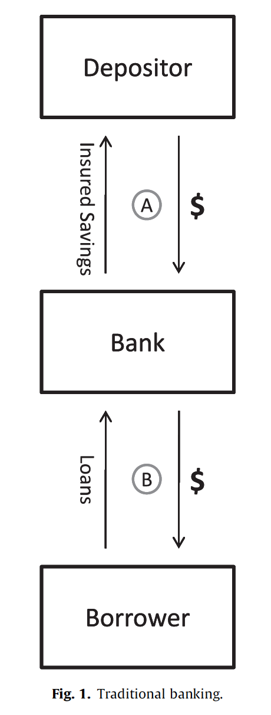
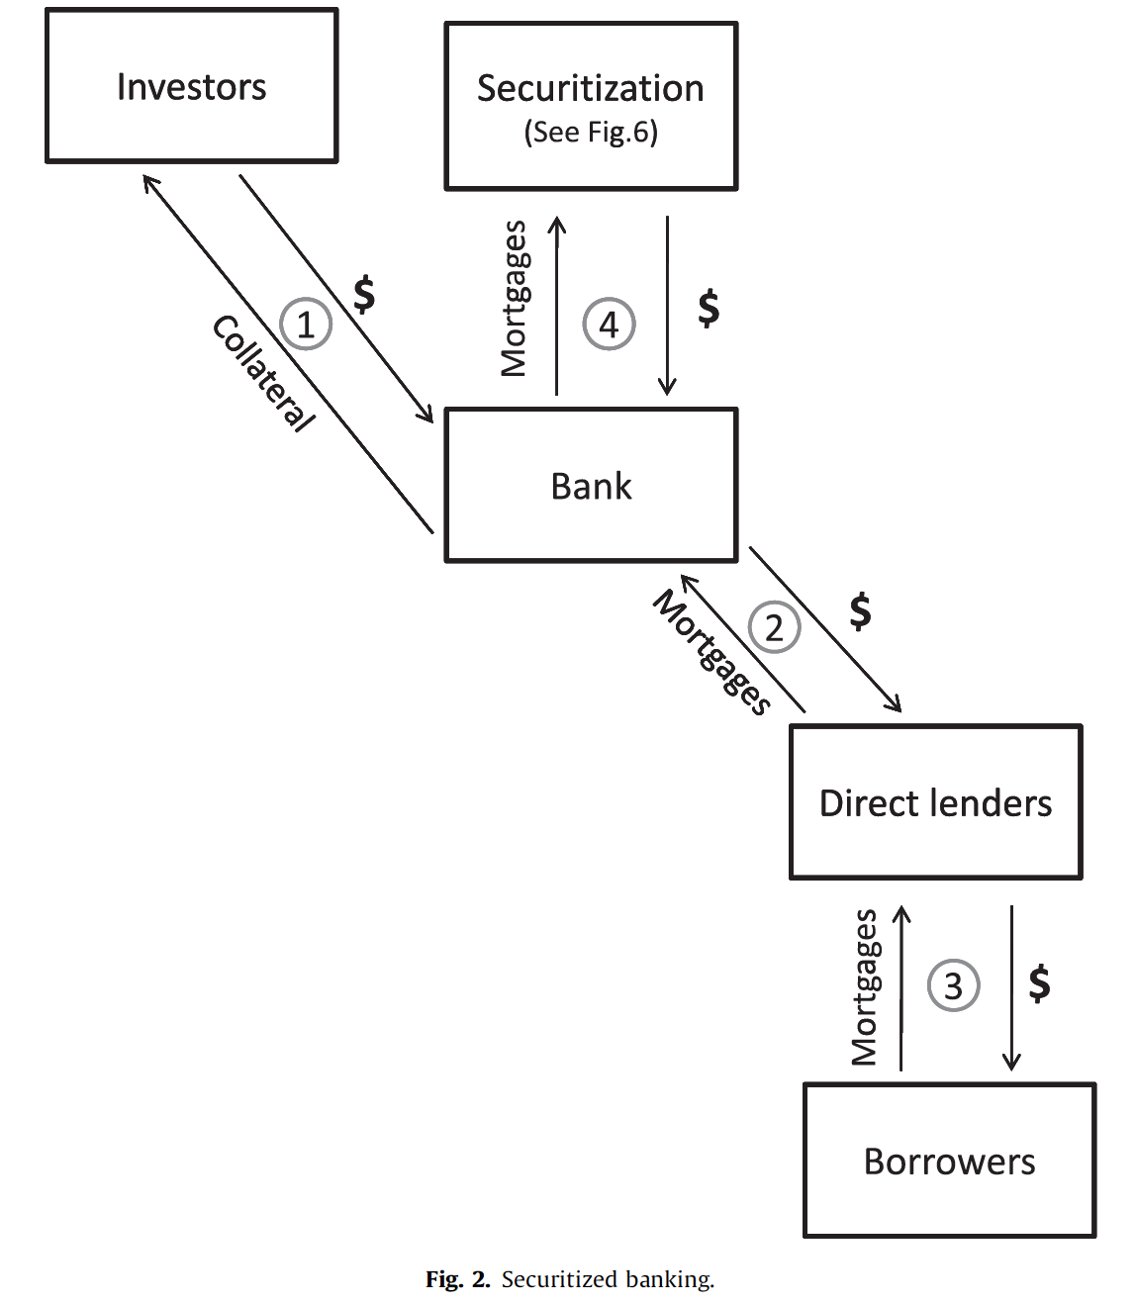
The investor buy some asset from bank for $X;
The bank agrees to repurchase the same asset later for $Y;
The market price of the asset is $Z;
Repo rate = (Y-X)/X
Haircut = (Z-X)/Z

Slide 6
Traditional banking
Securitized banking
Reserves: Minimum levels set by regulators; Shortfalls can be borrowed from central bank
Interest rates on Deposits: Can be raised to attract deposits when reserves are low
Haircut: Minimum levels set by counterparties; No borrowing from central bank
Repo rates: Can be raised to attract counterparties when funds are low

Slide 7
RUN ON REPO
REPO MARKET SIZE: $ 10 TRILLION
ZERO HAIRCUT: 100% FINANCING
20% HAIRCUT: SHORTAGE OF $2 TRILLION

Slide 8
CONTENTS
Introduction
Institutional background
State variables
Data
Empirical tests
Conclusion

Slide 9
THE SUBPRIME MORTGAGE MARKET
Provide housing finance to people with some combination of spotty credit histories, a lack of income documentation, or no money for a down payment

Slide 10
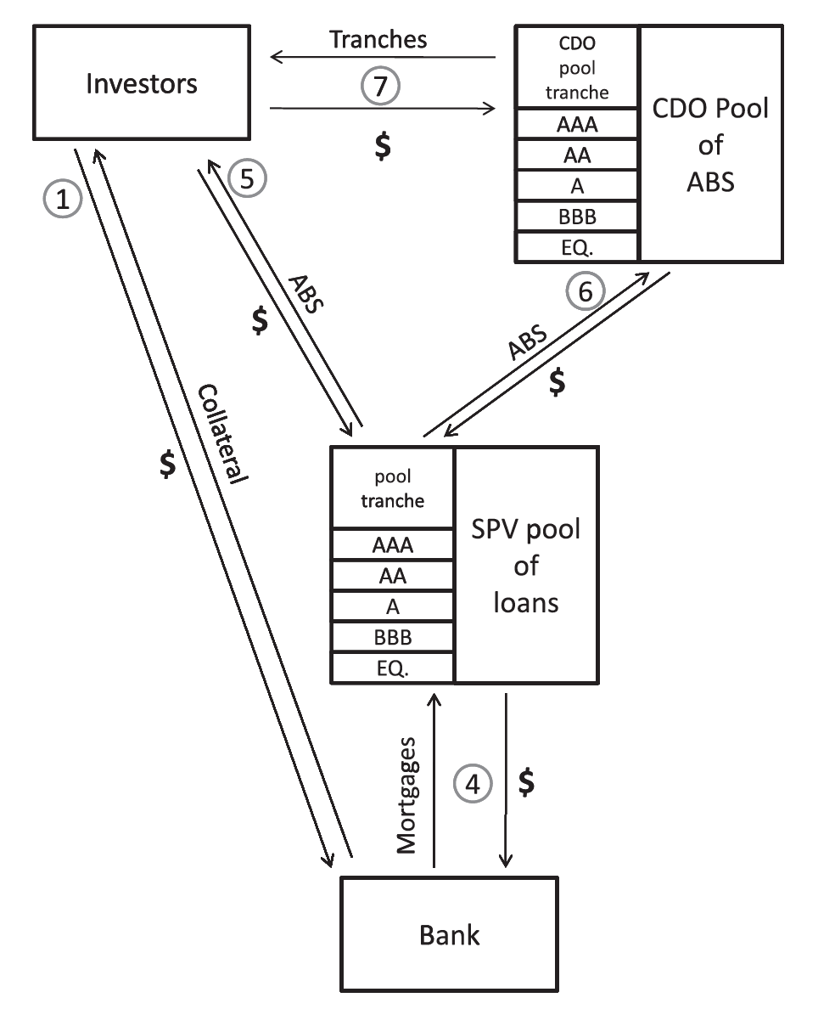
Securitization
SPV: for a special, limited, purpose by another entity
ABS: a bond that is backed by the cash flows from a pool of special assets
CDO: a SPV that buys a portfolio of fixed income assets and finances the purchase of the portfolio via issuing different tranches of risk

Slide 11
The repo market
Meet short-term liquidity needs
Market is very large

Slide 12
CONTENTS
Introduction
Institutional background
State variables
Data
Empirical tests
Conclusion

Slide 13
Subprime fundamentals -abx indices
ABX index is a credit derivative that references 20 equally weighted subprime RMBS tranches.
ABX index opened a relatively liquid, publicly observable market that priced subprime risk.

Slide 14
The interbank market -LIB-OIS SPREAD
LIBOR: the interest rate at which banks are willing to lend cash to other financial institutions
OIS: a fixed-to-floating interest rate swap
LIB-OIS: a pure measure of counterparty risk in the banking system

Slide 15
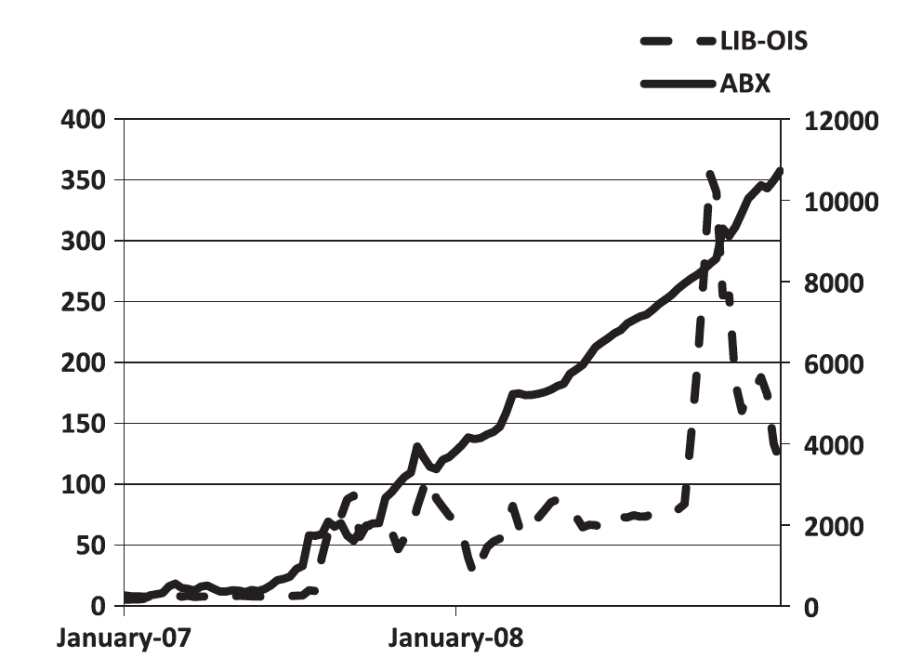

Slide 16
CONTENTS
Introduction
Institutional background
State variables
Data
Empirical tests
Conclusion

Slide 17
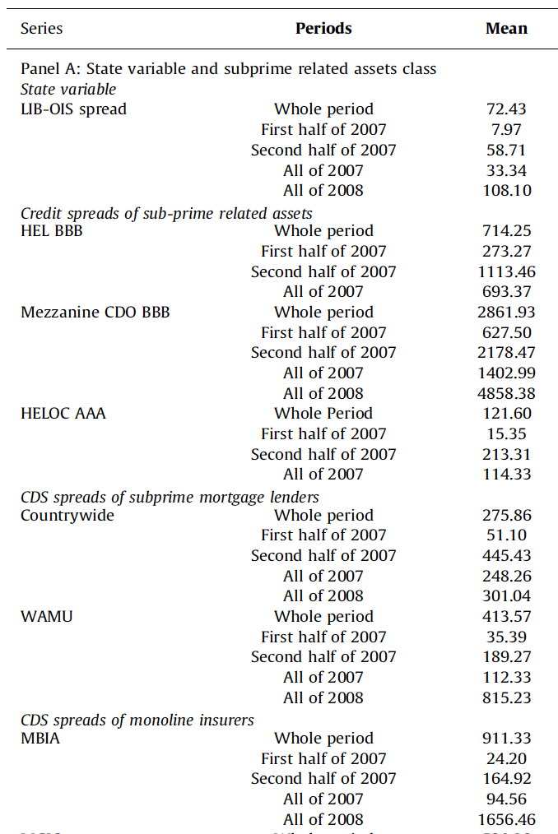
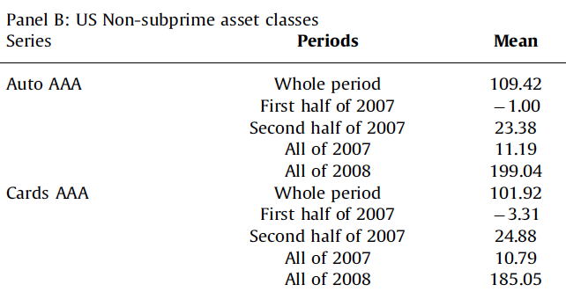
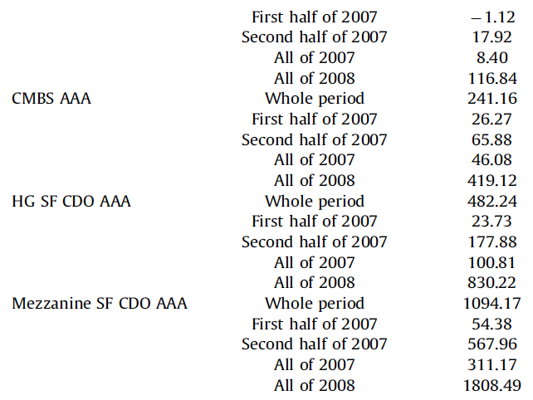

Slide 18
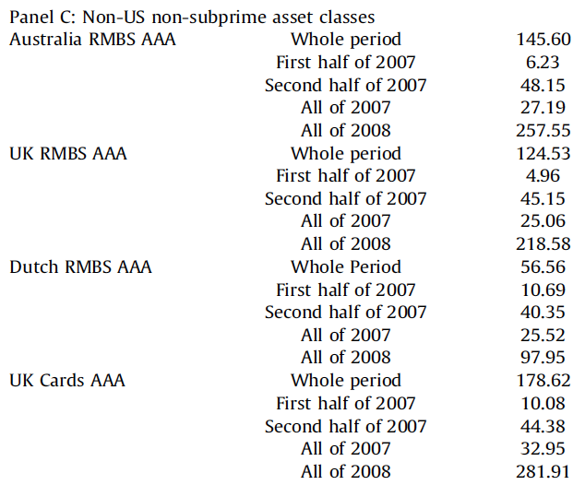
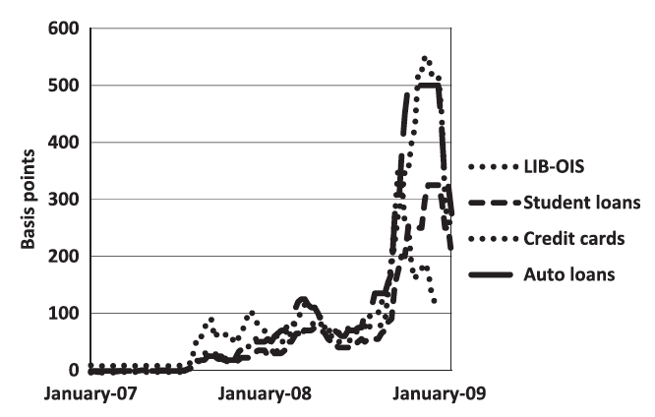
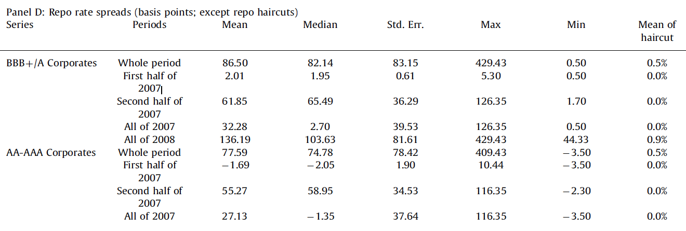

Slide 19
CONTENTS
Introduction
Institutional background
State variables
Data
Empirical tests
Conclusion

Slide 20
We want to test whether the spreads on US non-subprime-related asset classes(AAA) move with our state variables for the subprime market(ABX) and for interbank counterparty risk(LIB-OIS)
$$S_{i,t}=a_{o}+a_{1}t+b_{1}ABX_{t}+b_{2}LIB−OIS_{t}+b_{3}X_{t}+e_{i,t}$$
unit root
$${∆S}_{i,t}=a_{1}+b_{1}∆ABX_{t}+b_{2}∆LIB−OIS_{t}+b_{3}{∆X}_{t}+e_{i,t}$$
Control variables:
The ten-year constant maturity treasury rate
The square of 10YTreasury
The weekly return of the S&P500 index
The VIX index
The slope of the yield curve
The OIS
t is weekly time;
$S_{i,t}$ is the spread on asset i at time t;
$ABX_{t}$ is a vector of the last four observations of the ABX spread including the current period;
$LIB−OIS_{t}$ is a vector of the last four observations of the LIB-OIS spread including the current period;
$X_{t}$ is a vector of control variables

Slide 21
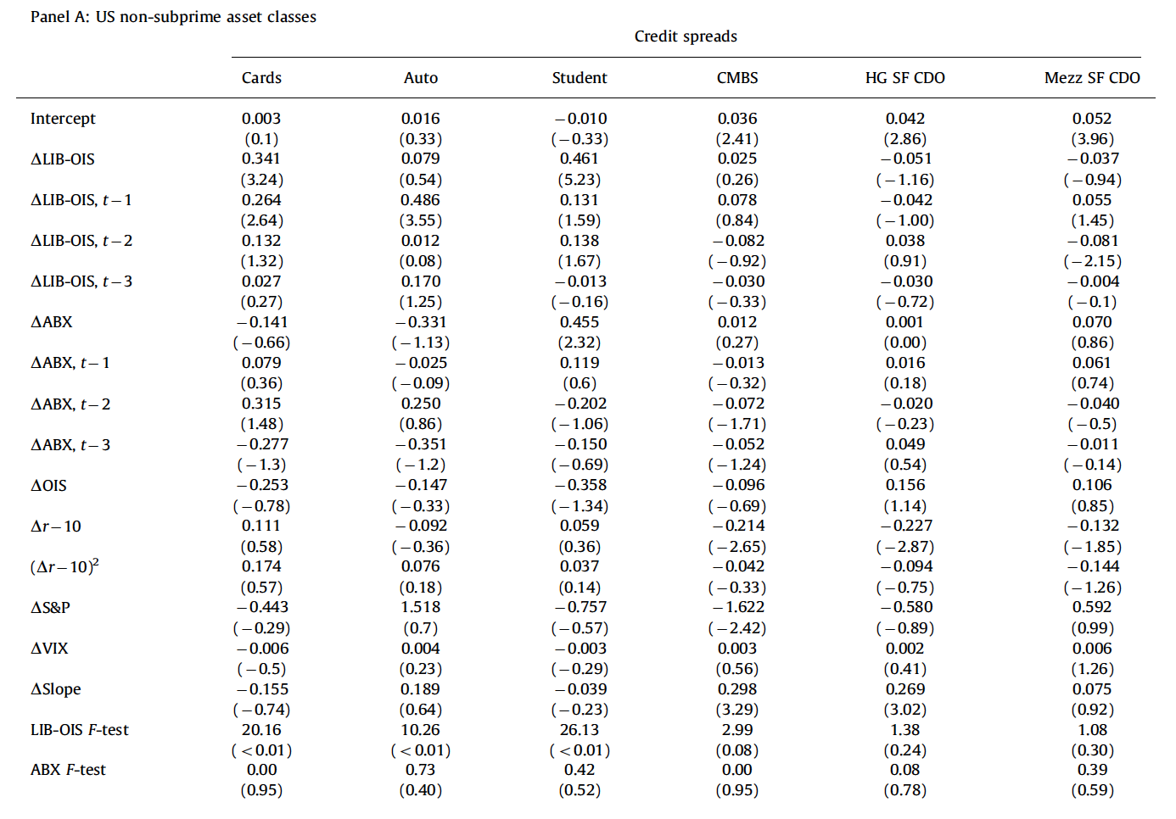

Slide 22
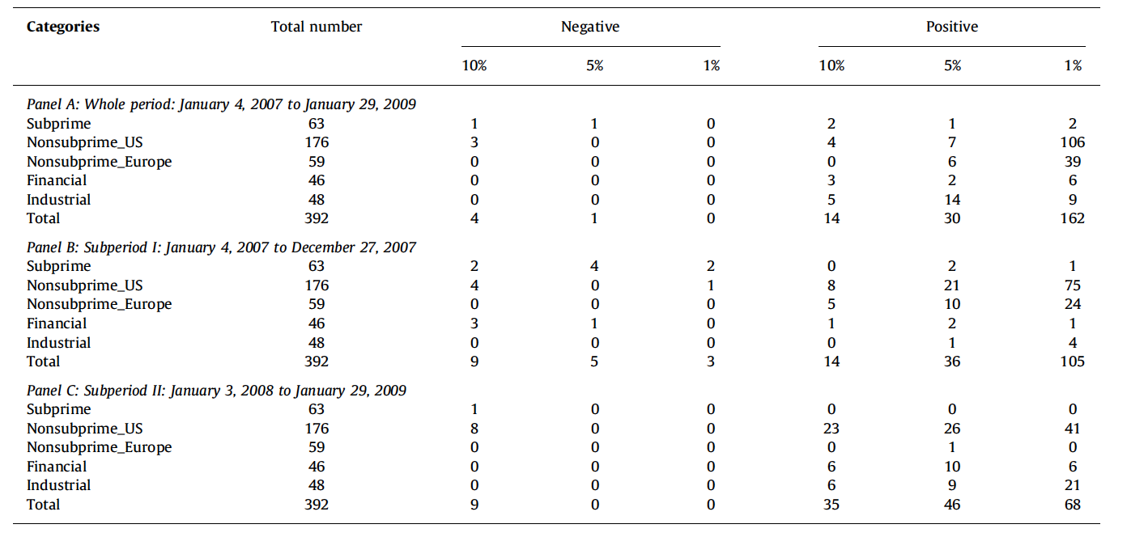

Slide 23
${∆R}_{j,t}=a_{1}+b_{1}∆ABX_{t}+b_{2}∆LIB−OIS_{t}+b_{3}{∆X}_{t}+ b_{4}∆VOL_{j,t}+e_{i,t}$
$R_{j,t}$ is the average spread of repo rates to the OIS for some class j of collateral
$VOL_{j,t}$ is a vector of the last four expected volatilities for that class of collateral
Repo Spreads

Slide 24
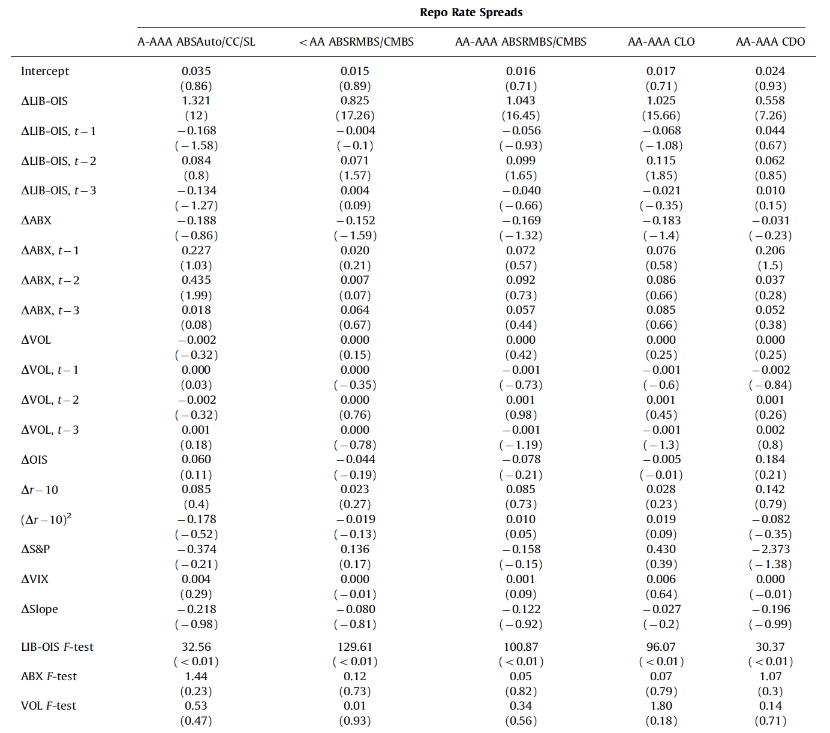

Slide 25
CONTENTS
Introduction
Institutional background
State variables
Data
Empirical tests
Conclusion

Slide 26
COnclusion
How did problems in the subprime mortgages cause a systemic event?
Is the weakening of subprime the shock that caused systemic problems?
What is the shock for the 1st systemic event?
Run in the repo market
No
LIB-OIS

Slide 27
opinions
Good:
Use a novel data set that includes credit spreads for hundreds of securitized bonds
Shortcomings:
Only structured securities(ABS, CDO…).
May overestimated the impact of haircut.
European market is different from US market

Slide 28
Thank you

